Slide 1
MySQL Index & Orchestrator

Slide 2
Agenda
MySQL Index
Orchestrator
ProxySQL

Slide 3
MySQL Index
B-Tree indexes
Hash indexes
Spatial (R-Tree) indexes
Full-text indexes
Other types of index

Slide 4
B-Tree index query types
Match the full value
Match a leftmost prefix
Match a column prefix
Match a range of values
Match one part exactly and match a range on another part
Index-only queries

Slide 5
B-Tree index limitations
Not useful for the lookup does not start from the leftmost side of the indexed columns
Can’t skip columns in the index
storage engine can’t optimize accesses with any columns to the right of the first range condition
eg. WHERE last_name=“Smith” AND first_name LIKE ‘J%’ AND dob=‘1976-12-23’ the index access will use only thefirst two columns in the index, because the LIKE is a range condition.

Slide 6
Hash indexes
A hash index is built on a hash table and is useful only for exact lookups that use every column in the index. For each row, the storage engine computes a hash code of the indexed columns, which is a small value that will probably differ from the hash codes computed for other rows with different key values. It stores the hash codes in the index and stores a pointer to each row in a hash table.
In MySQL, only the Memory storage engine supports explicit hash indexes. They are the default index type for Memory tables, though Memory tables can have B-Tree indexes, too.

Slide 7
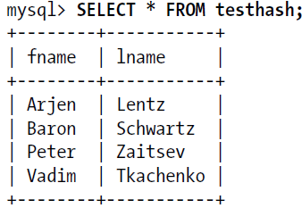
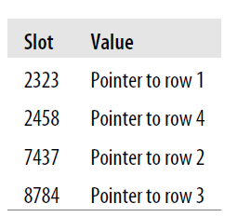
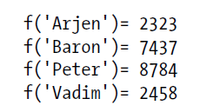
Hash index table
CREATE TABLE testhash (
fname VARCHAR(50) NOT NULL,
lname VARCHAR(50) NOT NULL,
KEY USING HASH(fname)
) ENGINE=MEMORY;
mysql> SELECT lname FROM testhash WHERE fname='Peter';
MySQL will calculate the hash of 'Peter' and use that to look up the pointer in the
index. Because f('Peter') = 8784, MySQL will look in the index for 8784 and find the
pointer to row 3. The final step is to compare the value in row 3 to 'Peter', to make
sure it’s the right row.

Slide 8
Building your own hash indexes
If your storage engine doesn’t support hash indexes, you can emulate them yourself in a manner similar to that InnoDB uses. This will give you access to some of the desirable properties of hash indexes, such as a very small index size for very long keys.
The idea is simple: create a pseudohash index on top of a standard B-Tree index. It will not be exactly the same thing as a real hash index, because it will still use the B-Tree index for lookups. However, it will use the keys’ hash values for lookups, instead of the keys themselves. All you need to do is specify the hash function manually in the query’s WHERE clause.

Slide 9
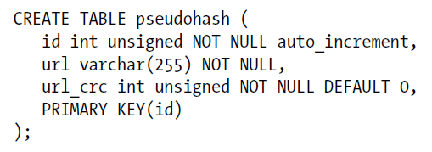
Building custom index case
This works well because the MySQL query optimizer notices there’s a small, highly
selective index on the url_crc column and does an index lookup for entries with that
value (1560514994, in this case). Even if several rows have the same url_crc value, it’s
very easy to find these rows with a fast integer comparison and then examine them to
find the one that matches the full URL exactly. The alternative is to index the full URL
as a string, which is much slower.

Slide 10
Benefits of Indexes
Indexes reduce the amount of data the server has to examine.
Indexes help the server avoid sorting and temporary tables.
Indexes turn random I/O into sequential I/O.
Note : An index isn’t always the right tool.

Slide 11
Indexing Strategies for High Performance
Isolating the Column
Prefix Indexes and Index Selectivity
Multicolumn Indexes
Choosing a Good Column Order
Clustered Indexes

Slide 12

Isolating the Column

Slide 13
Prefix Indexes and Index Selectivity
A prefix of the column is often selective enough to give good performance. If you’re indexing BLOB or TEXT columns, or very long VARCHAR columns, you must define prefix indexes, because MySQL disallows indexing their full length.
The trick is to choose a prefix that’s long enough to give good selectivity, but short enough to save space. The prefix should be long enough to make the index nearly as useful as it would be if you’d indexed the whole column. In other words, you’d like the prefix’s cardinality to be close to the full column’s cardinality.

Slide 14
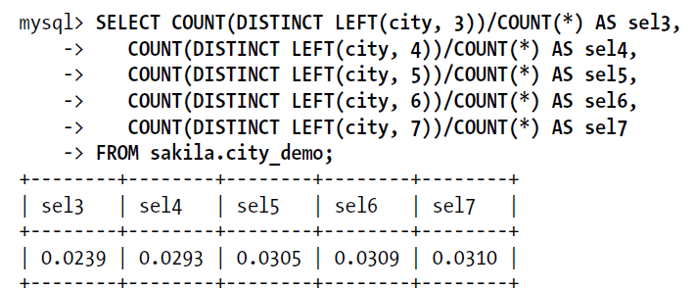
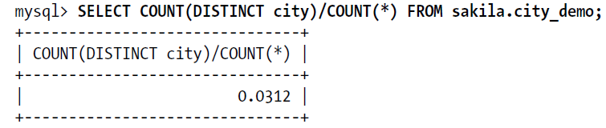
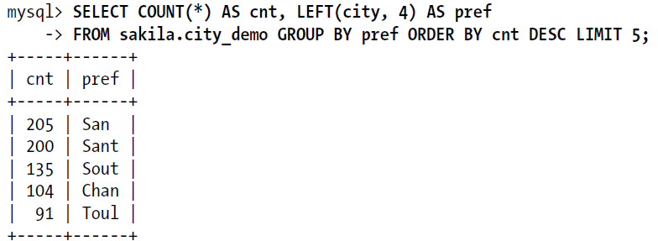
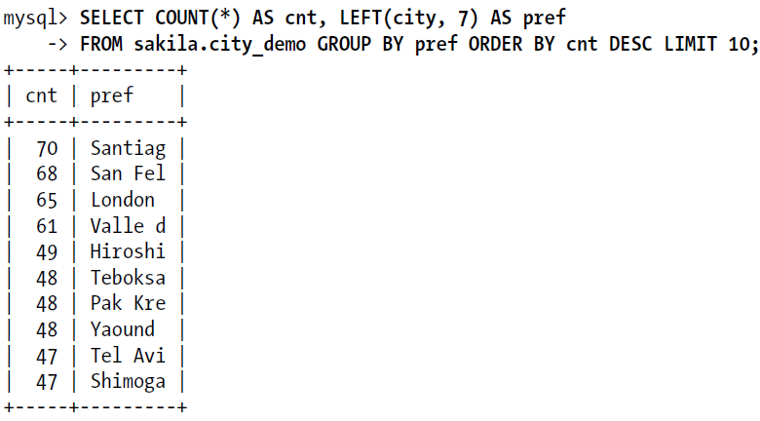
Index Selectivity case

Slide 15
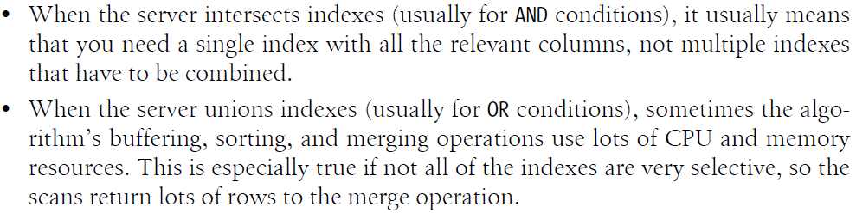
Multicolumn Indexes
CREATE TABLE t (
c1 INT,
c2 INT,
c3 INT,
KEY(c1),
KEY(c2),
KEY(c3)
);
“create indexes on columns that appear in the WHERE clause.” -wrong

Slide 16

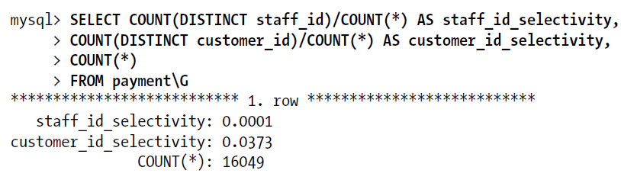
Choosing a Good Column Order
Placing the most selective columns first can be a good idea when there is no sorting or grouping to consider, and thus the purpose of the index is only to optimize WHERE lookups. In such cases, it might indeed work well to design the index so that it filters out rows as quickly as possible, so it’s more selective for queries that specify only a prefix of the index in the WHERE clause.

Slide 17
Clustered Indexes

